Slide 1

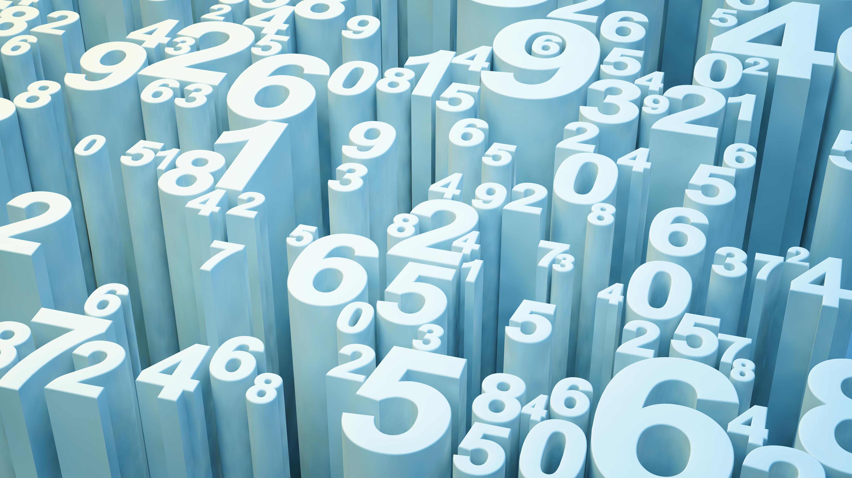
Super Market Billing Calculation System
Abhishek Pal
(Sec- H 06 2014524 3rd Sem)
B.Tech ( CSE Core )

Slide 2
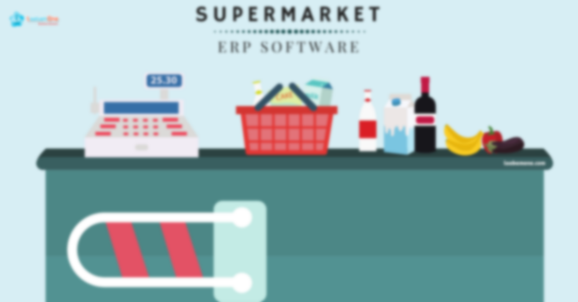
A Project Based on Super Market Billing Calculation System Declaration:
I Abhishek Pal declare that the mini project entitled “Super Market Billing Calculation System” submitted to Graphic Era Deemed to be University for consideration of degree of Bachelor of Computer Science & Engineering (CSE, 3rd Sem) embodies our own work with suggestion received during the work, which have been suitably acknowledged.

Slide 3
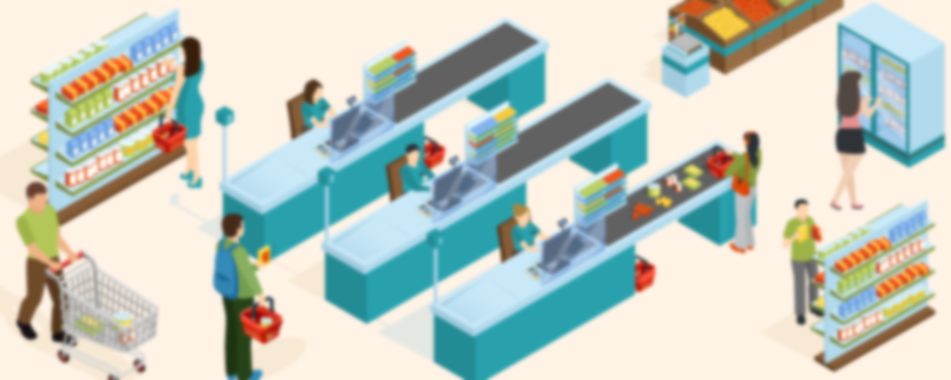
Table of contents:
Abstract
Introduction
Objectives
Conclusion
Technology & tools
Data flow diagram
Source code

Slide 4

Abstract:
The Project “supermarket” deals with the automation of supermarket. This software will help salespersons in managing the various types of Records pertaining to his/her customer. The product will help the user to work in a highly effective and efficient environment.
The salespersons have been recording the customer information in the past and even in the present through their personal manual efforts. And indeed, it consumes their considerable time and energy that could be utilized in the better productive activities. Apart from that, with increasing customer Strength, the task of managing information of each individual customer is indeed a cumbersome task.
There is a lot of reason for the introduction of this project. In the manual System, there are number of inefficiencies that a salesperson faces. The information retrieval is one of the foremost problems. It is very difficult to gather the overall performance reports of the customer. Large records - books have to be maintained where relevant and irrelevant information has to be stored which is very untidy and clumsy process.
On the other hand, there are many inherent problems that exist in any manual system. Usually, they lack efficiency. Less efficiency has a great impact on the productivity of any human being keeping the data up to date.
Therefore automation deals with all such problems and tries to remove them in the best suitable fashion. The new system will cater to the need of the salespersons of any supermarket so that they can manage the system efficiently. The project “supermarket” is developed with the objective of making the system reliable, easier, fast, and more informative.

Slide 5

Introduction:
Supermarket is the place where customers come to purchase their daily using products and pay for that. There is a need to calculate how many products are sold and to generate the bill for the customer. In my project and implementation we have 3 users. First is the data entry operator who will enter the products in the database. Second one is the administrator who will decide the taxes and commissions on the products and can see the report of any product. Third one is the bill calculating operator who will calculate the bill and print..
Many supermarkets use this type of billing system for a decade. It is also improved many times according to requirements of sellers and customers. It does the same work that is calculating the bill, gives it to the customer and maintain proper database. They are accurate in calculation and printing, they also generate records.
A new concept is also added in the billing system is that they also maintain relationships with the customers who purchase more products from the store regularly. System also concerns their requirements and gives them moew commission. It also shows the overall profit and profit on a particular product and give reports which items are required and which have cross their expiry data.

Slide 6

Objectives:
Data entry operator will enter the information of the product in database.
The administrator will enter the taxes and commissions for each product.
The customer will come and take the basket with him/her and choose the product and took it to the counter.
The bill calculating operator will check the products with the bar code detecting machine then it will match with product id then it will show its information and price and the bill will be calculated and total payment will shown.
Customer will pay for the products.
All the products will be packed and delivered to the customer

Slide 7

Technology & tools used:
C++ Programming Language
Software used: Codeblocks

Slide 8

Modulus:
Customers
Products

Slide 9
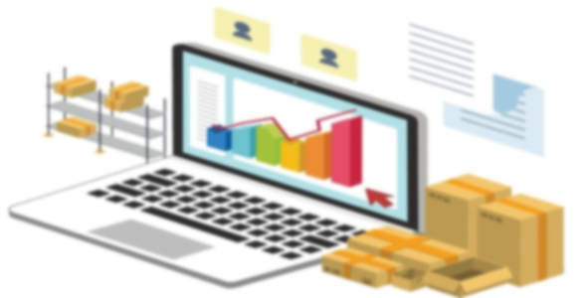
Data Flow Diagram:
Customers
Request for items
Marketing
(Super Market)
Item supply
Demand for stock supply
Supply stock and invoice no.
Supplier

Slide 10

Benefits:
Supermarket has large turnover
Low cost of operation.
Shopping is very easy and quick.
Freedom of selection.
Saving in labor due to self – service system.

Slide 11

Source Code:
Will see and continue in Codeblocks
Its my Source Code link :- https://github.com/Abhishek2717/miniproject/blob/main/2014524_miniprojectcode.cpp

Slide 12

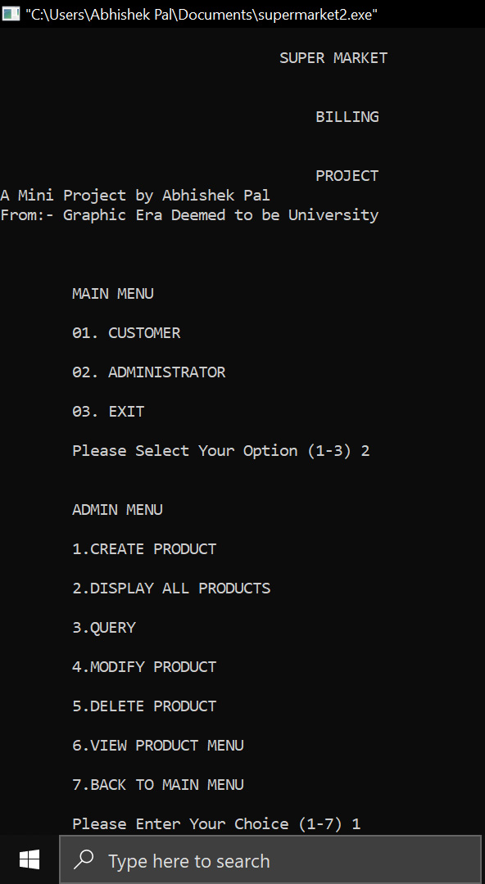
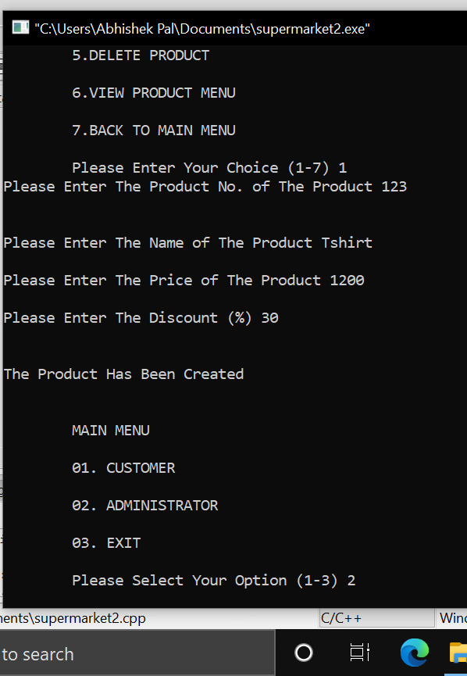
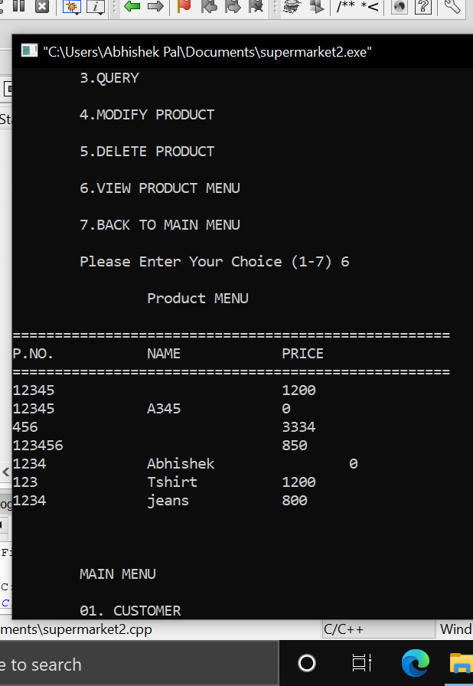
Output(1st part):

Slide 13
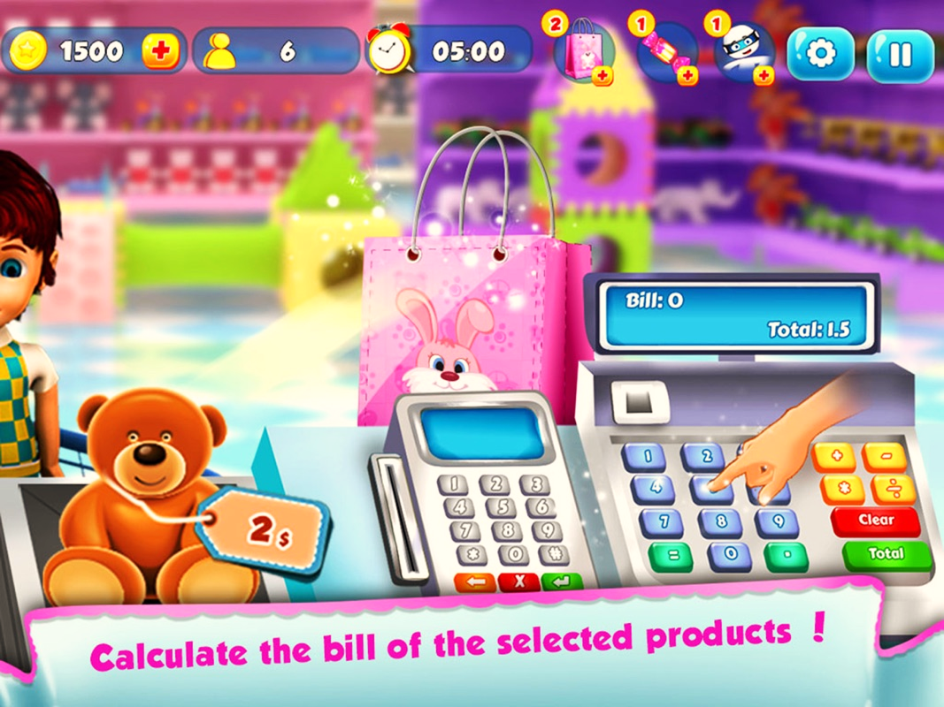
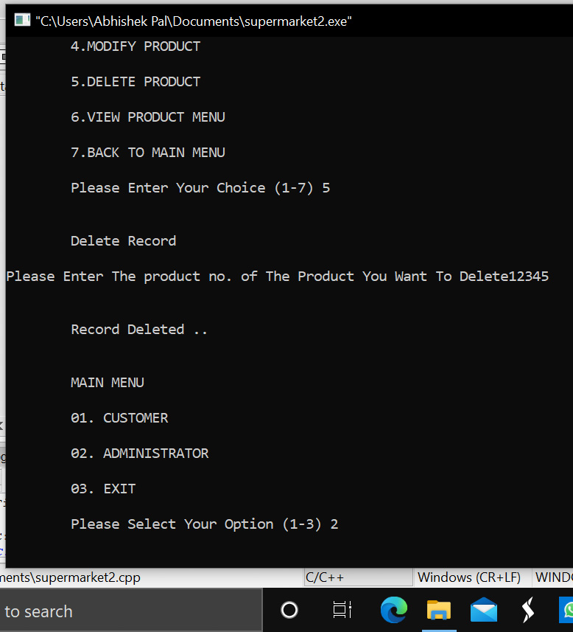
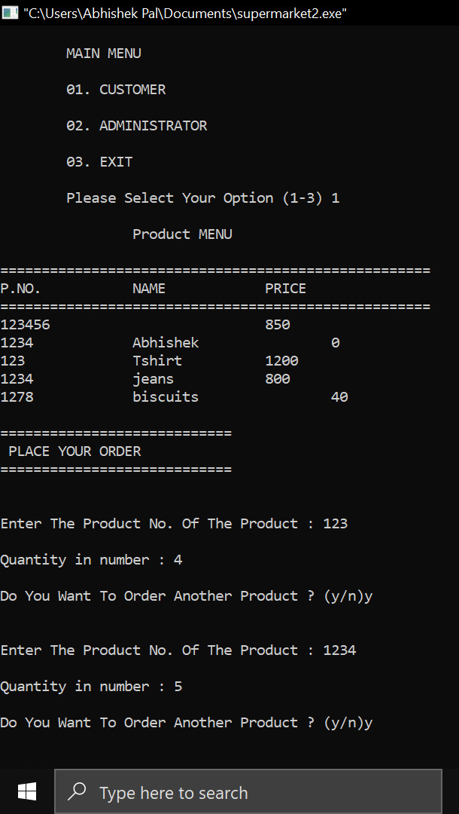
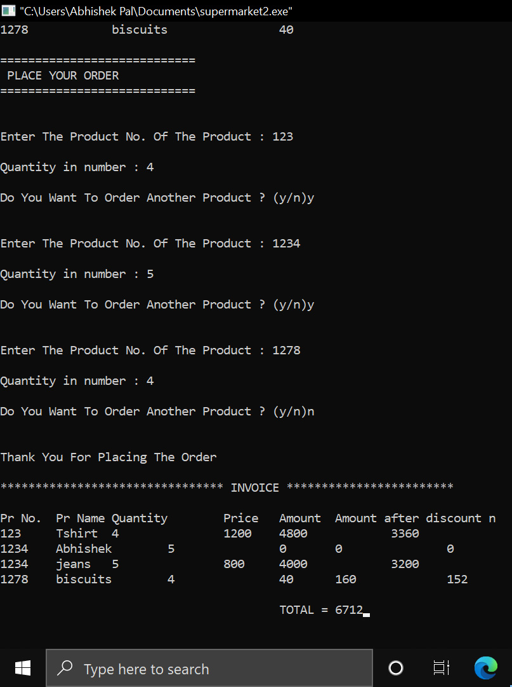
Output(2nd part):

Slide 14

Conclusion:
My project and implementation is on supermarket billing calculation system. I successfully completed it. I take this opportunity to express my sense of indebtedness and gratitude to all those teachers, friends, resources like google, books who helped me in completing this project and implementation.
I am immensely grateful to our esteemed project guide MR. Pankaj Kumar (Professor CSE) guidance without which this work would not have been possible this project and implementation has contributed a lot to my knowledge that has proved to be a value addition for us.

Slide 15
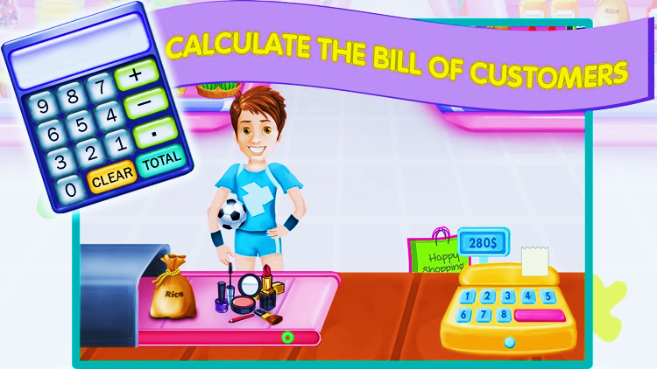
Reference:
www.google.com
www.wikipedia.com
Mr.Pankaj Sir(cc)

Slide 16
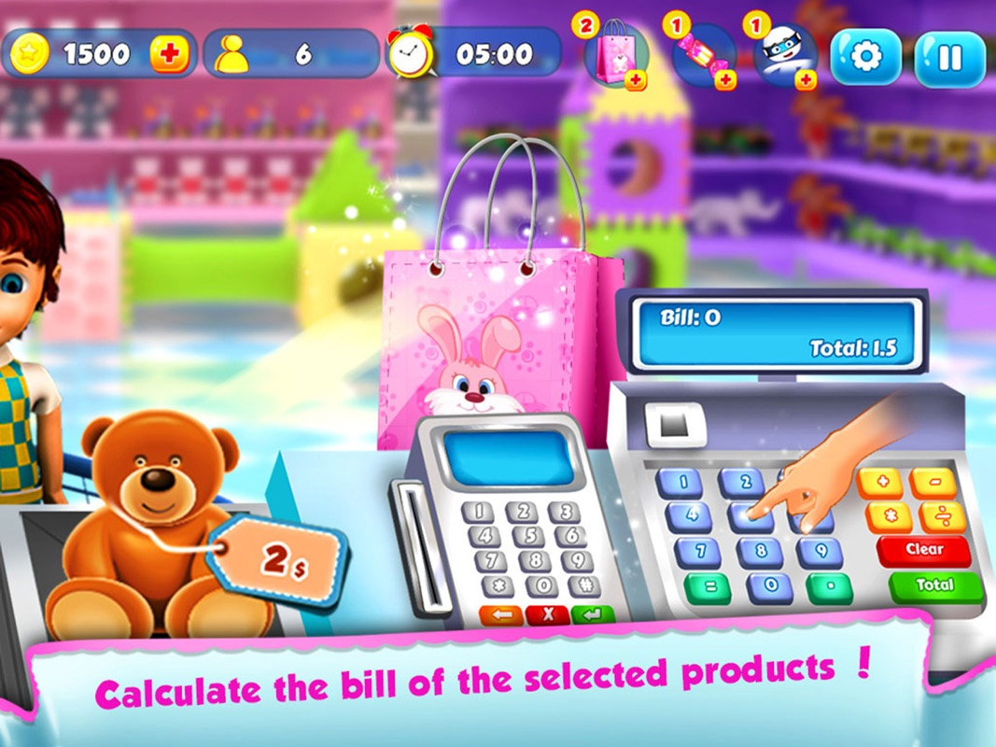
Thank You

